Slide 1
Industrial IOT: OT is Evolving to IT Methodologies
Operational
Technology
Information
Technology
Isolated from the Internet
Connected to the Internet
Security is critical in both environments
Need to control 1000’s of workloads and 10,000’s of IOT devices with limited headcount
OT is no longer static – need to remotely deploy, monitor, update, and manage devices
OT is moving towards the IT Management/Orchestration approach
Industrial Apps
Maintenance
Business Apps
Data Protection
UI: Control Panel
UI: Web Browser
Converging Compute
Monitoring
Control Processes
Storage
Networking
Focus: Uptime & Safety
Focus: Security
Extreme Temperatures & Humidity
Controlled Stable Environment
Requirement: Unified architecture that spans traditional IT and Edge/Operations Technology

Slide 2
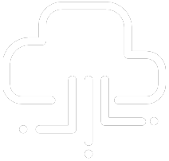

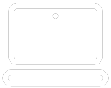
App 1
App 2
App 3
Bins/Libs
Bins/Libs
Bins/Libs
Guest OS 1
Guest OS 2
Guest OS 3
App 1
App 2
App 3
App 1
App 2
App 3
Bins/Libs
Bins/Libs
Bins/Libs
Bins/Libs
Hypervisor
Container Engine
Operating System
Host Operating System
Operating System
Infrastructure
Infrastructure
Infrastructure
Bare-Metal
Virtualized
Containers

